Slide 1
Procedural programming
Retrospection – C language

Slide 2
Programming
Using a programming language
To write program lines to instruct the executor to carry out a specific task
Program lines contain language primitives
Language rules allow to combine primitives to complex programs
Programs are executed by the computer to automate tasks

Slide 3
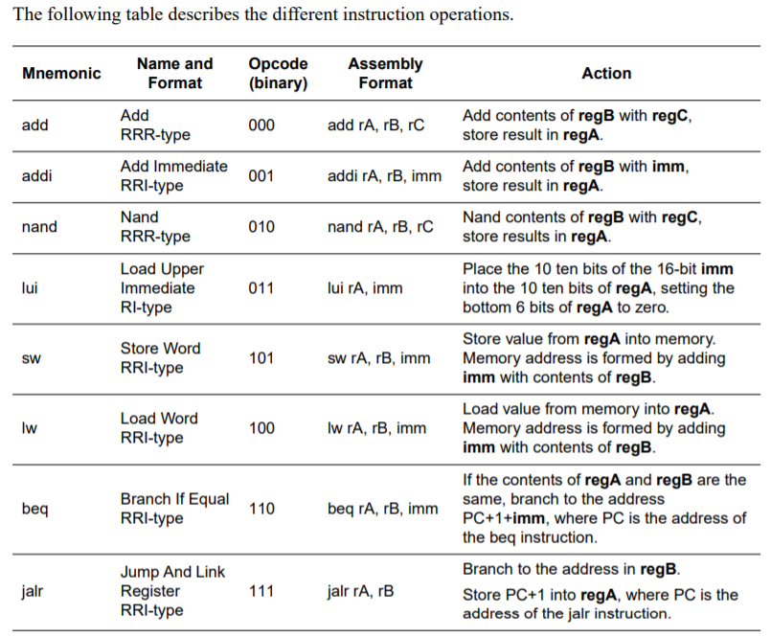
Language primitives
Instructions which can be executed by a computer
(RiSC-16)
Working in this environment id HARD:
Boilerplate

Slide 4
Boilerplate
Coming from newspaper printing…
In computer programming, boilerplate code or just boilerplate refers to sections of code that have to be included in many places with little or no alteration.
Boilerplates are
take the most of development resources
good sources of bugs

Slide 5
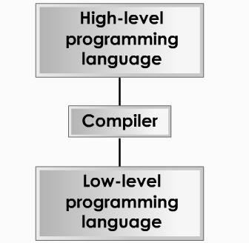
High level programming languages
Better understood by human
Preimplemented boilerplates → API
With good language specification, platform independent source code can be created
Programming paradigms
C, C++, C#, Java, Pascal, Delphi, Basic

Slide 6
Paradigm
In science and philosophy, a paradigm is a distinct set of concepts or thought patterns, including
theories, research methods, postulates, and standards
for what constitutes legitimate contributions to a field.

Slide 7
Programming paradigms
A way to classify programming languages based on their features
Imperative
Declarative
the programmer instructs the machine how to change its state
structured – structures flow into blocks and control statements
procedural - groups instructions into procedures
object-oriented - groups instructions together with the part of the state they operate on
the programmer declares properties of the desired result, but not how to compute it
functional - the desired result is declared as the value of a series of function applications
logic - the desired result is declared as the answer to a question about a system of facts and rules
mathematical - the desired result is declared as the solution of an optimization problem

Slide 8
Structured programming
Aimed at improving the clarity, quality, and development time of a computer program by making extensive use of the structured control flow constructs of
code blocks
selection
repetition - iteration
subroutines

Slide 9
Procedural programming
Derived from structured programming, based upon the concept of the procedure calls. Procedures, also known as subroutines or functions, simply contain a series of computational steps to be carried out.
Any given procedure might be called at any point during a program's execution, including other procedures or itself.
Procedures are
stateless (by definition)
but can work on global variables (can maintain state)
make only data transformation

Slide 10
Procedural programming components – C
Variables, types, type casts
User defined types
Arrays, strings, constants
Operators, precedence, overload
Control statements
Code modules and parameters
Dynamic memory management, data references
Function pointers – method references

Slide 11
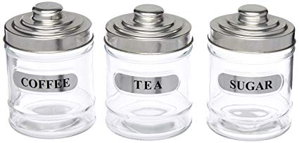
Variable
Variable
data storage unit of memory
can be referred by its name
stores a data with predefined type
the stored data is a subject of change
int counter;
counter = 1;
counter = 2;

Slide 12
Primitive types
Data types specify the amount of allocated memory for a variable, and the method of its usage.
The C language contains numeric data types which support basic arithmetical operations, and it provides possibility to create user defined types.
Primitive types: char, int, float, double, boolean (unsigned char)
Modifiers: signed/unsigned, short/long

Slide 13
Primitive types – example
How much space has to be allocated and how it should be threated to store age and speed data.
unsigned char age = 12; // 0..255 (1 byte, as is)
float speed = 826.8 * 3.6; // exact speed in m/sec
(4 byte, 32 bit: 0-22 mantissa, 23-30 exponent, 31 sign)
speed = (-1)^s*m*2^(e-127)

Slide 14
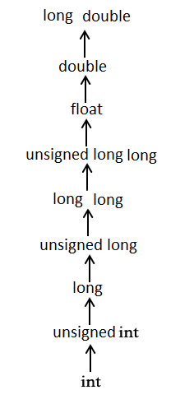
Type casts
When variables of multiple types appear in an expression, type conversion is required.
This is done by the compiler in the following steps
Integer promotion
Types smaller than int are casted to int
Types are converted to the highest appearing element of the hierarch

Slide 15
Type casts – automatic up
int i = 17;
char c = 'c'; // ASCII value of ’c’ is 99
float sum; // int and char to double
sum = i + c; // Value of sum : 116.000000

Slide 16
Type casts – automatic down
double length = 33.3;
int boxLength; // Double to int
boxLength = length; // Value of boxLength : 33
// Automatic type cast to less data

Slide 17

Type casts – questions
int d = 18 / 5;
int e = ’c’ / 10;
float q1 = 18 / 5;
float q2 = (float)18 / 5;
// Value of d: 3
// ’c’ == 99, Value of e: 9
// Value of q1: 3.0
// Value of q2: 3.6

Slide 18
Custom types
Programmer can create custom types at compile time for
structured use of logically connected data
optimal use of storage space
increasing source code readability

Slide 19
Enumeration type
Custom type, created by the programmer at compile time
Collection of named integer constants
Goals:
Specify exact set of values of an integer variable
Increase code readability by using names instead of values
Created by enum keyword
Names have to be globally unique

Slide 20
Enumeration type
enum color { red, green, blue };
enum color favorite_color;
printf(”Please pick a color\n");
printf("1-red, 2-green, 3-blue:");
scanf("%d", &favorite_color);
switch (favorite_color)
{
case red:
printf(”Red selected");
break;
case green:
printf("Green selected");
break;
case blue:
printf("Blue selected");
break;
default:
printf(”Wrong selection");
}

Slide 21
Structs
Custom type created by the programmer at compile time
Collection of logically connected values of different type
Structure of collection is set at compile time
Structure of collection can not change at run time

Slide 22
Example of struct
Name of created type
typedef struct Product {
int price;
int vatPercent;
} Product;
Create new variable:
Product newProduct;
Access data member:
newProduct.price = 951;
newProduct.vatPercent = 15
Data members of structure
Alias of created type

Slide 23
Union data storages
Created at compile time, to store multiple type of data exclusively
Only one member of struct is in use at a time
Shares the allocated memory between possible stored types
Allocates memory for the biggest storage type
Minimizes the allocated memory
Application requires high care

Slide 24
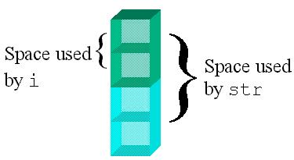
Example of union
union SomeUnion {
int i;
char str[4];
}
Allocated 4 bytes instead of 6

Slide 25
Arrays
Collection of items of same type – type can not be changed
Number of items set at compile time – can not be changed
Items stored one after another in the memory
Items can be modified independently
Items accessed by indexer (index operator)

Slide 26

Example of arrays
Declaration of one dimensional array:
int score[7] = {5, 2, 8, 0, 1, 9, 4};
for(int i=0; i<7; i++) {
score[i] += 10;
}

Slide 27
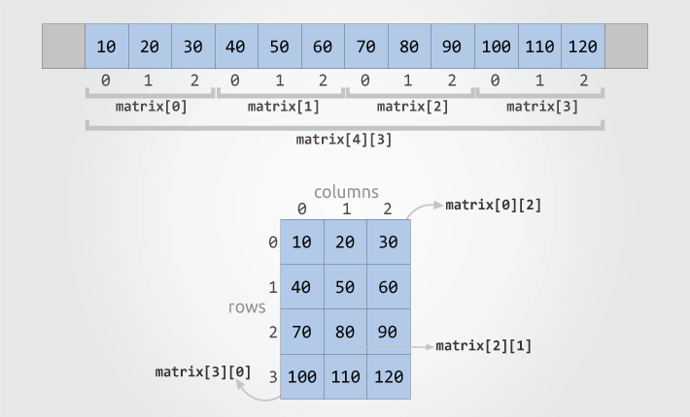
Example of array
Two dimensional array:
int matrix[4][3] = {
{10, 20, 30},
{40, 50, 60},
{70, 80, 90},
{100, 110, 120}
};

Slide 28
String type
A built in type to store text data: ”Hello world”
In C, string is a ”\0” terminated char array (or NULL) egy karakter tömb (end of valid text is marked by a terminal ”\0”)
char message[]=”Hello!”;
char message[7]={’H’,’e’,’l’,’l’,’o’,’!’,’\0’};

Slide 29
Literal constant
Storage of a specified type (primitive or array)
With referrable allocated memory area (lvalue)
Pointer can be created for this allocated memory
Can be string data (char array)
int literal = 19;
85 /* decimal int */
0213 /* octal */
0x4b /* hexadecimal */
30u /* unsigned int */
30l /* long */
30ul /* unsigned long */
”Hello world!” /* string */

Slide 30
Constants
Typed data storage without referable memory storage (rvalue).
Creation:
#define processor instruction
#define LENGTH 10
const keyword
const int WIDTH = 5;
usage
printf("value of area : %d", LENGTH * WIDTH);

Slide 31
Code block – scope
Collection of logically coherent instructions
Bounded by curly braces: { <instructions to execute> }
Variables defined in a blokk can be used only in that block
A name space, a variable with the defined name exists only in it – scope
Variable defined in a block hides variables defined outside ones

Slide 32
Scope of variable – local/global
Declaring code block is the scope of the variable – variable is local in it
In C source files variables can be declared outside of code blocks. In this case, the scope is the compilation unit – variable is semiglobal - global in compilation unit
With extern modifier, scope of variable can be extended between compilation units. Scope of such a variable is all of the compilation units – this variable is global
Variables global by default do not exist (can not exist - linking)

Slide 33
Operators
Operator is a symbol which tells the compiler to perform specific mathematical or logical function.
Operator types:
Arithmetic
Relational
Assignment
Bitwise
Logical
Misc (sizeof, ?:)
In C language operator can not be created for custom types

Slide 34
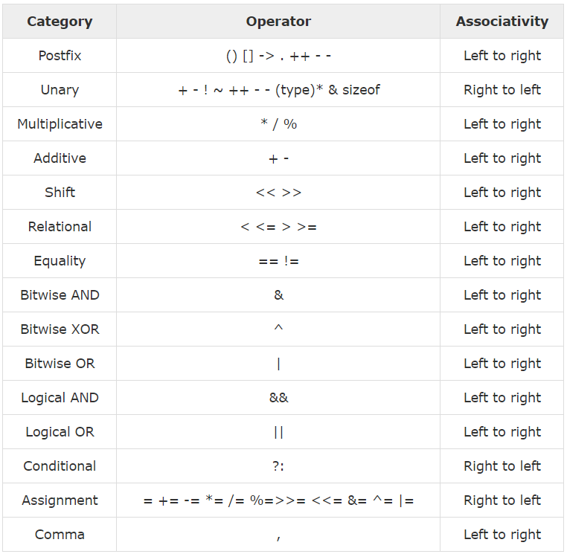
Operator precedence
Use brackets!
Able to read!

Slide 35
Control statements
Statements to control the flow of instruction execution.
Execution is independent from other instructions
Can be nested in any level and any combination

Slide 36
Control statements - sequence
Series of sequentially executed statements.
Terminal of statements: ”;”
printf(”Hello”);
printf(”World”);
char *name = ”Tamas”;
printf(”I am %s”, name);

Slide 37
Control statements – selection
One/Two-way
Multiple-way
When nested in multiple levels, hard to read and follow
Can be controlled by any boolean expression
Conditions can contain intervals and
else branch can be absent
Easy to follow with multiple choices
Only primitive type can control
Conditions are constant values
Can have a default branch

Slide 38
Control statements – selection
Two-way condition:
if(<condition>) {
<execute when condition is true>
}
else {
<execute when condition is false>
}

Slide 39
Control statements – selection
Two-way condition example:
if(x>=0) {
y=sqrt(x);
}
else {
printf(”No square root for negative numbers”);
}

Slide 40
Control statements – selection
Multi-way selection:
switch(primitive expression) {
case <constant expression> :
break;
case <constant expression> :
case <constant expression> :
break;
default:
}

Slide 41
Control statements – selection
Multi-way selection example:
switch(dice) {
case 1:
case 3:
case 5:
printf(”number is odd”);
break;
case 2:
case 4:
case 6:
printf(”number is even”);
break;
default:
printf(”Not a dice”);
}

Slide 42
Control statements – selection
How to choose:
Execution has one or two ways
if with or without else
Execution has more ways
Control independent or complex logical expressions: nested if statements
Control by constants: switch-case

Slide 43
Control statements - iteration
Repetition of a code block is specified by a condition
Modification of the control condition is required in the cycle body to finish the iteration

Slide 44
Control statements - iteration
while
The while statement evaluates a control expression before each execution of the loop body
while(<control expression>) {
<statements to execute, modification of control expression>
}

Slide 45
Control statements - iteration
do-while
The do-while statement evaluates the control expression after each execution of the loop body.
do {
<statements to execute, modification of control expression >
} while(<control statement>);

Slide 46
Control statements - iteration
for
The for statement evaluates three expressions and executes the loop body until the second controlling expression evaluates to false.
for(<init expression>;<control expression>;<modification expression>) {
<statements to execute>
}
int cycles;
boolean hasEmail = false;
for(; cycles>0&&!hasEmail; cycles--)
{
printf(count);
hasEmail = checkEmails();
}
for(int i=1;i<=10;i++) {
printf(i);
}
while

Slide 47
Control statements - iteration
while – runs only the control condition is true (possibly never)
do-while – runs at least once, than until the control conditions is true
for – number of iteration is exactly known on run time

Slide 48
Function
Separable part (module) of the executable task
Collection of logically related instructions
Can be referred by name
Can have input parameter
Have return value

Slide 49
Function declaration
<return type> <function name>([formal parameter list])
{
<function body>
}
int square(int value) {
return value*value;
}

Slide 50
Function parameters
Parameters declared in the formal parameter list can be referred by their name in the message body.
Formal parameters:
Given in compile type
Actual parameters:
Given in run time
Formal parameter
int square(int value) {
return value*value;
}
int main(int argc, char *argv[]) {
int length = 5;
int area = square(length);
}
See later…
Actual parameter

Slide 51
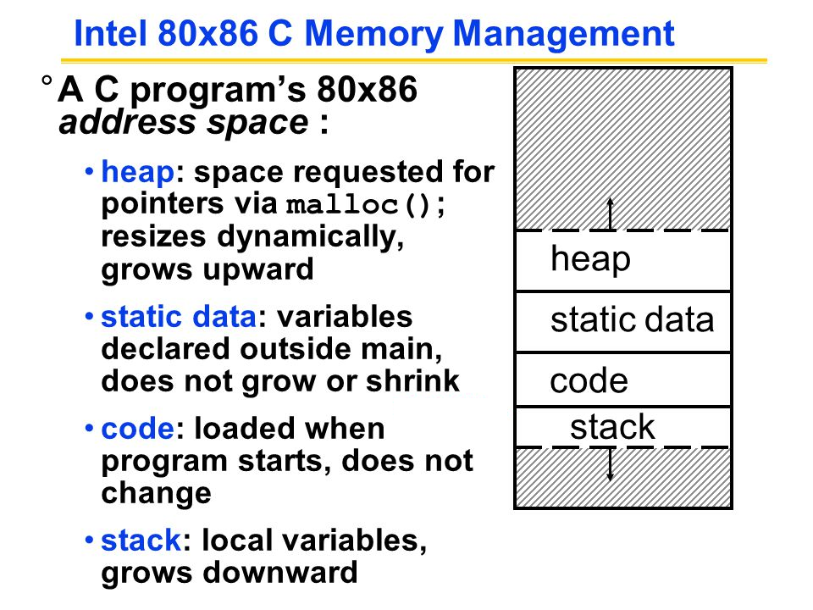
Primitive memory management
Primitive types are stored in stack
Declaration is in compile time
Run time allocation is missing
Scope + LIFO organization reduces stack fragmentation
Unused local variables take the place until end of scope
The stack fix, small size (single segment)
Heap is unused

Slide 52
Dynamic memory management
Run time allocation
Allocate storage in heap
Allocated memory is releasable
Heap is the all free memory
Heap can be fragmented

Slide 53
Dynamic memory management
Utilization of memory allocated in heap requires:
Allocate required amount of memory
A local variable – pointer type
Declares the name of reference
Refers the exact location of the allocated area (segment:offset)
Specifies the size and utilization method of allocated area (size, type – meaning of bits)
This local variable (like others) stored in stack
After finishing the usage, allocated space has to be released

Slide 54
Pointer type
Properties of pointer type variable:
Primitive type, stored in stack
Describes the type of referred area (typed pointer)
Its value is the address of the pointed area
Can point to local, static and dynamic variable (in stack or in heap)
Its value is subject of change (the address)
Value can be NULL (does not contain valid address)
Accessing pointed value by * operator

Slide 55
Pointers in action
x (int) = 12
heap
pi (float) = 3.14
y (int*)
name (char*)
count (int) = 8
8 byte (Rect)
4 x int
(x,y,h,w)
area (float*) = NULL
rect (Rect) = {x,y,h,w}
rectRef (Rect*)
6 byte (char[6])
”Tamás” + 0
stack
2 byte (int)

Slide 56
Management of pointers
Primitive type, allocated in stack
Its value is a memory address
Stored data (referred address) can be changed (move forward/back, set, NULL)
Movement is valid inside the allocated area
Then the pointer is void, no type check on usage
Can refer valid and invalid memory address (after set or release)
On assignment, the address is copied, not the referred data

Slide 57
Usage of pointers
int number = 10;
int *numPtr = &number; // numPtr points to number
// & is the ’address of’ operator
number = 20; // number is 20
*numPtr = 30; // number is 30, set via pointer
// * is the ’points to’ operator
numPtr = 40; // WRONG!!! Invalid address is set

Slide 58
Pointers and arrays
Arrays are stored in heap, dynamically
Array type variable is a typed pointer
Pointer can be used to refer an array item
What is the difference?

Slide 59
Pointers and arrays
Arrays can be accessed through pointers
int score[7] = {5, 2, 8, 0, 1, 9, 4};
int *scorePointer = score;
score[2] = 10;
*(scorePointer + 2) = 10;

Slide 60
Method parameters
Formal parameters are value types (primitives or pointers)
On calling, values of actual parameters are copied to formal parameters
When a value has to be modified inside a function, its reference has to be passed as a value argument. A pointer type formal parameter receives a reference value of an actual parameter.

Slide 61
Method parameters – value/reference
int height=10;
int width=20;
void extend(int a, int *b) {
a *= 2;
*b *= 3;
}
extend(height, &width); //height is 10, width is 60

Slide 62
Usage of pointers
char *string1=”Hello World!”;
char string2[20];
void stringCopy(char *dest, char *src) {
while(dest++ = src++);
}
char src[13]={’H’,’e’,’l’,’l’,’o’,’ ’,’W’,’o’,’r’,’l’,’d’,’!’,’\0’};
char *ptr = src[0]
// *(ptr+4) = src[4] = ’o’

Slide 63
Dynamic memory management
<type> *<ptr_name> = (<type>*) malloc(<total_byte_size>);
<type> *<ptr_name> = (<type>*) calloc(<unit_count>,<unit_size>);
int *intPtr = (int*)malloc(100 * sizeof(int)); //allocation
free(intPtr); //release
float *floatPtr = (float*)calloc(100, sizeof(float)); //allocation
free(floatPtr); //release
Dynamically allocated memory can be handled as array

Slide 64
Memory allocation and release
Reservation is done in run time, before usage
Accessing allocated area through pointers
After usage, release through pointer
Release is NOT AUTOMATIC!
Allocated area can be released only once
One area can be referenced by multiple pointers
If there is no reference to an allocated area, it can not be accessed, nor released. The application leaks memory and can run out of resource.

Slide 65
Heap fragmentation
x (int) = 12
heap
Allocated areas can be reallocated after release
If release order is not the reversed order of allocation, holes can fragmentation appears in heap.
frame (Rect*)
y (int*)
name (char*)
rect (Rect*)
8 byte (Rect)
4 x int
(x,y,h,w)
6 byte (char[6])
”Tamás” + 0
stack
2 byte (int)

Slide 66
Classification of types by access
Value or pointer
Only reference
Primitive types
Enumerations
Typed pointers
Void pointers
Arrays
String literals (char array)
Dynamically allocated areas (malloc/calloc)

Slide 67

Dynamic linked lists
List reference
NULL
List item 1
[Item]
List item 2
[Item]
Data fields
Data fields
Item pointer
Item pointer
NULL
NULL

Slide 68
Dynamic linked lists
typedef struct Item {
<custom data>
Item *nextItem
} Item;
Item *firstItem;
firstItem = NULL;
Item newItem;
newItem.nextItem = NULL;
firstItem = &newItem;

Slide 69
Function pointer
Address of first instruction of the function to execute. Can be used like data pointers.
void my_int_func(int x)
{
printf( "%d\n", x );
}
void (*foo)(int);
foo = &my_int_func;
foo( 2 );
(*foo)( 2 );

Slide 70
Subtask injection
Sort an array of a user defined class in a generic component.
With n properties, there are n! sort permutations.
Executor
int byName(User a, User b)
{…}
int byAge(User a, User b)
{…}
void sort( User users[], int size, void (*subOp)(int)) {…}
Injection
sort(users, count, &byName);
sort(users, count, &byAge);
Subtasks

Slide 71
Basic language components – C
Variables, types, type casts
User defined types
Arrays, strings, constants
Operators, precedence, overload
Control statements
Code modules and parameters
Dynamic memory management, data references
Function pointrers – method references

